Slide 1
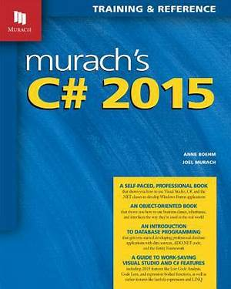
Programming
Lecture 11
Windows Form Part 2

Slide 2
Agenda
User Input
Keyboard
Mouse
Timer
CheckBox
ComboBox

Slide 3
User Input in Windows Form Application
Definition
In Windows Forms, user input is sent to applications in the form of Windows messages. A series of overridable methods process these messages at the application, form, and control level. When these methods receive mouse and keyboard messages, they raise events that can be handled to get information about the mouse or keyboard input.

Slide 4
User Input in Windows Application
Keyboard and mouse
All Windows Forms controls inherit a set of events related to mouse and keyboard input.
The KeyPress event to determine the character code of a key that was pressed, or a control can handle
The Mouse Click event to determine the location of a mouse click.

Slide 5
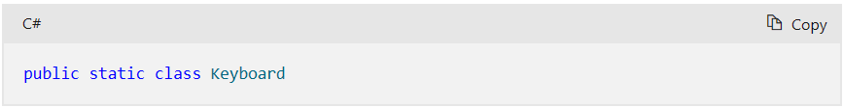
Keyboard
Definition
Namespace:
System.Windows.Input
Assembly:
PresentationCore.dll

Slide 6
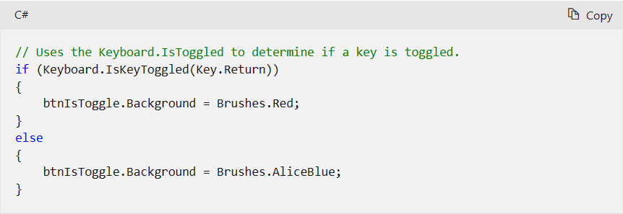
Keyboard
The following example shows how to use the IsKeyToggled method to determine if a key is in the toggled state. If the Key passed to IsKeyToggled is toggled, the background of a button is changed.

Slide 7
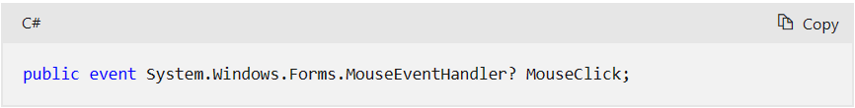
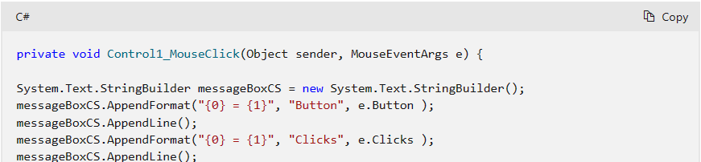
Mouse
MouseClick

Slide 8
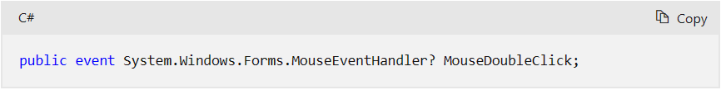
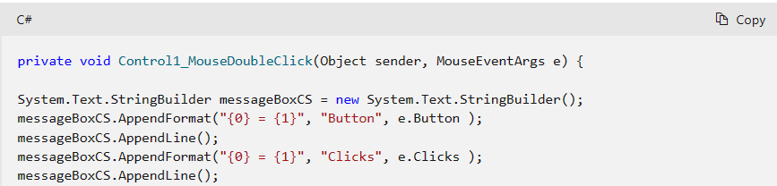
Mouse
2. MouseDoubleClick

Slide 9
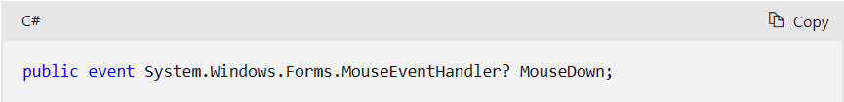
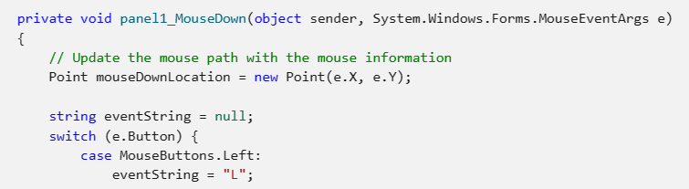
Mouse
3. MouseDown

Slide 10
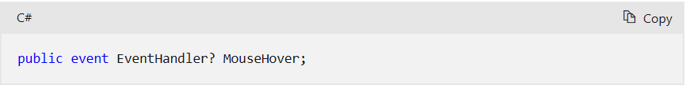
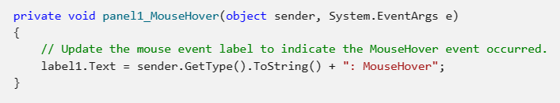
Mouse
4. MouseHover

Slide 11
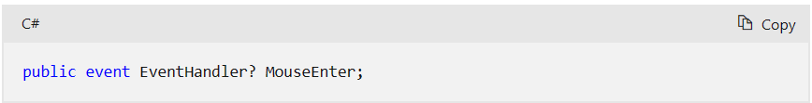
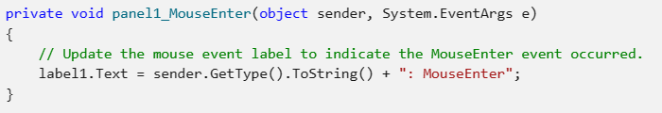
Mouse
5. MouseEnter

Slide 12
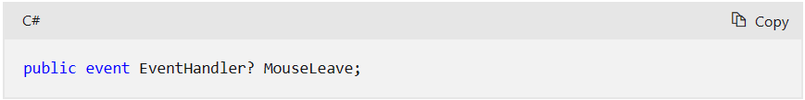
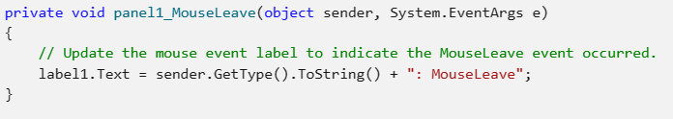
Mouse
6. MouseLeave

Slide 13
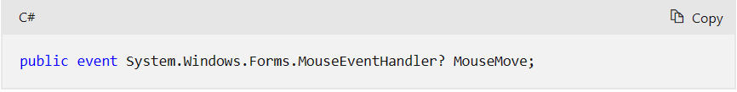
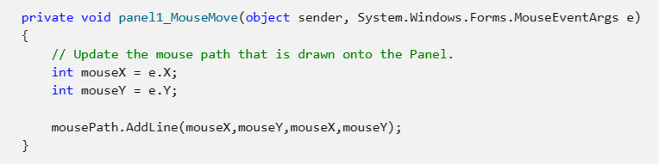
Mouse
7. MouseMove

Slide 14
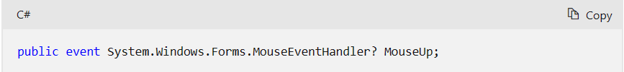
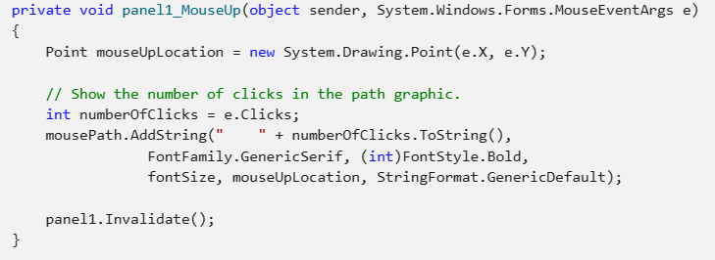
Mouse
8. MouseUp

Slide 15
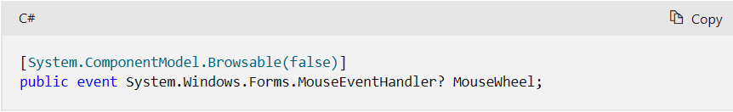
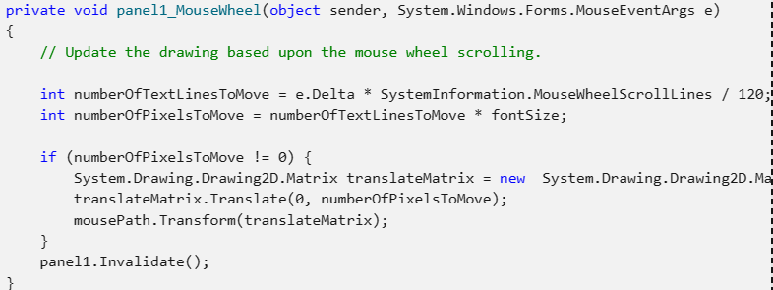
Mouse
9. MouseWheel

Slide 16
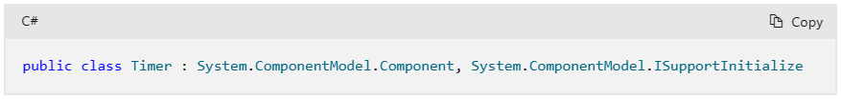
Timer
Definition
Namespace:
System.Timers
Assembly:
System.ComponentModel.TypeConverter.dll

Slide 17
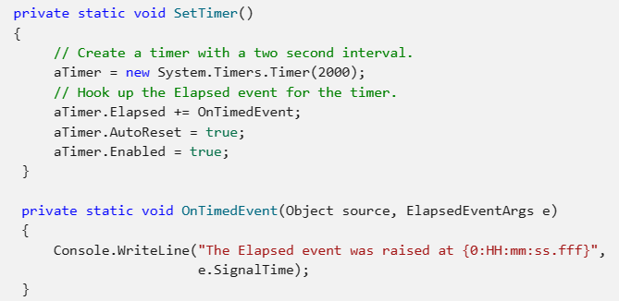
Timer
Set Event to Timer

Slide 18
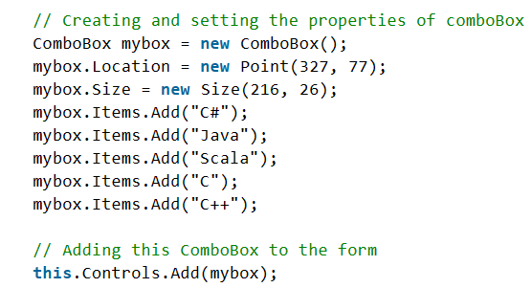
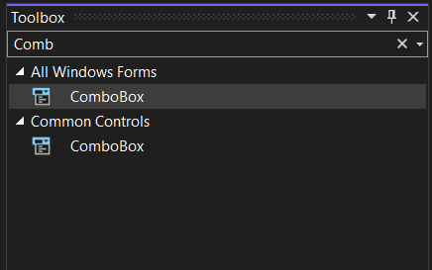
ComboBox
Add Item to ComboBox - Option 1 (In source)

Slide 19
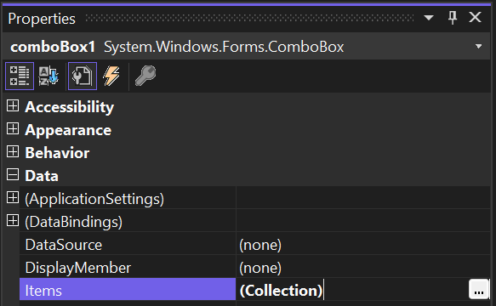
ComboBox
Add Item to ComboBox - Option 2 (In Design)
In Properties Panel , choice Data -> Items to add items

Slide 20
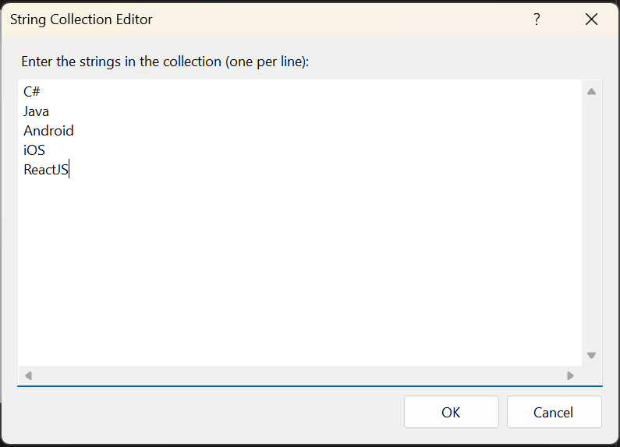
ComboBox
Add Item to ComboBox - Option 2 (In Design)
Choice Component to show String Collection Editor. Enter value s (one per line)

Slide 21
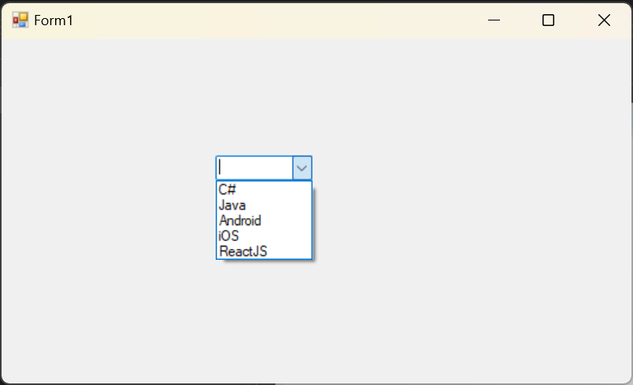
ComboBox
ComboBox example

Slide 22
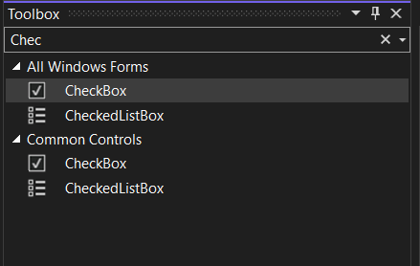
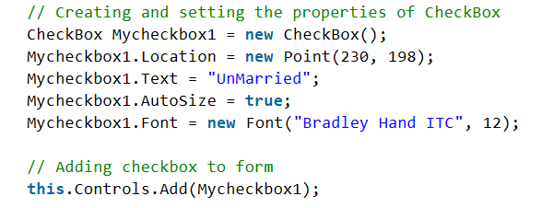
CheckBox
Setting CheckBox properties (In Source)

Slide 23
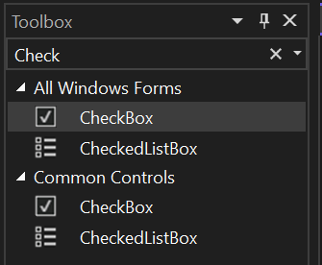

CheckBox
Setting CheckBox properties (In Design)
In Toolbox -> Search CheckBox and drag Checkbox to Form

Slide 24
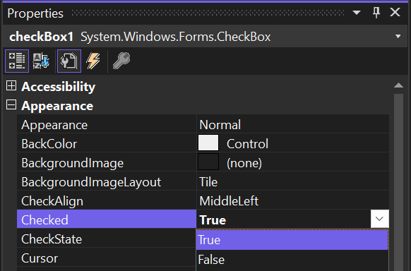

CheckBox
Set CheckBox is selected
In Properties panel, choice Appearance -> change Checked = True

Slide 25
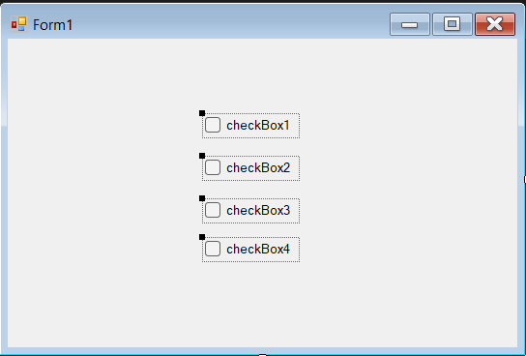
CheckBox
CheckBox example

Slide 26
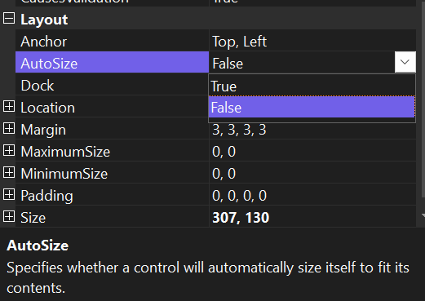
CheckBox
CheckBox Resize
In default, CheckBox can not Resize. To resize Checkbox choice AutoSize = False in Properties panel

Slide 27
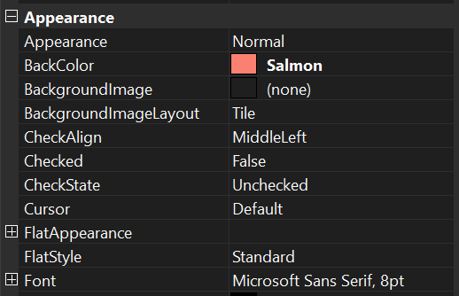
CheckBox
CheckBox Color
Choice Appearance -> BackColor

Slide 28
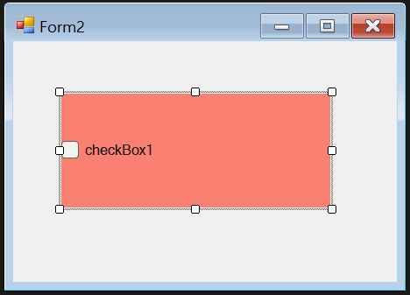
CheckBox
CheckBox Color
Result like next figure

Slide 29
Remarks
Notes:
If the Three State property is set to true, the Checked property will return true for either a checked or indeterminate state.
Use a CheckBox to give the user an option, such as true/false or yes/no. The CheckBox control can display an image or text or both.
CheckBox and RadioButton controls have a similar function: they allow the user to choose from a list of options.
CheckBox controls let the user pick a combination of options. In contrast, RadioButton controls allow a user to choose from mutually exclusive options.

Slide 30
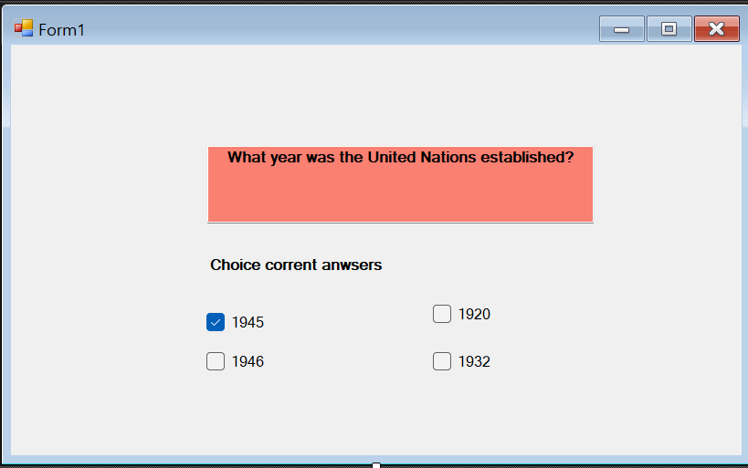
Practices
1. Quiz Test
Design Form Quiz Test
Show Message Box when choice correct answer.

Slide 31
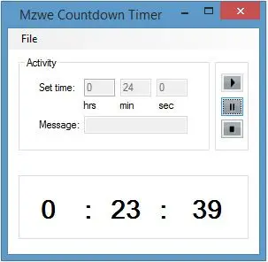
Practices
2. Countdown Timer
Design Form Countdown Timer
Set time
Set Message
Add Event Timer when end time

Slide 32
Thank you!
Notes:
32

